Slide 1
Module 6 Sustaining Success and Future Planning
www.restart.how
This project has been funded with support from the European Commission. This publication [communication] reflects the views only of the author, and the Commission cannot be held responsible for any use, which may be made of the information contained therein.

Slide 2
Intro
What does community regeneration success look like? And how do you evaluate it?
MODULE 6 OVERVIEW
01
Common Barriers to Success and how to overcome them
Our final module helps you assess what does community regeneration success look like? And how do you evaluate it?
You will also learn that celebrating success is one of the most important things you can do. You will learn about the importance of reassurance marketing, vital as we emerge from the pandemic of 2020.
We provide our last set of practical templates and exercises which you can use to measure the success and impact of your projects and plan for the future for your community regeneration projects.
02
Sustaining Success – the role of young people and volunteers in your community
03
Sharing and celebrating your success – innovative reassurance marketing techniques and approaches
04
Can’t stand still ! Build on success and plan for the Future
KEY ACTION PACK 5:
Useful exercises and templates to help you secure funding/finance for your projects

Slide 3
INTRODUCTION: WHAT DOES COMMUNITY REGENERATION SUCCESS LOOK LIKE?
And how do you measure it?

Slide 4
COMMUNITY REGENERATION SUCCESS
Once you have brought your community regeneration project to completion, measuring the process and the impact is a valuable practice. It provides a learning opportunity for future undertakings, and the opportunity to assess the true effectiveness of the project. Assessing impact in a deep way is vital.
Evaluation is process that you can use to measure the success of your projects. Evaluation enables you to gather information and evidence to quantify and share the value and quality of your project. So many fail to do this, typically worn out getting to completion, but it is so important.

Slide 5
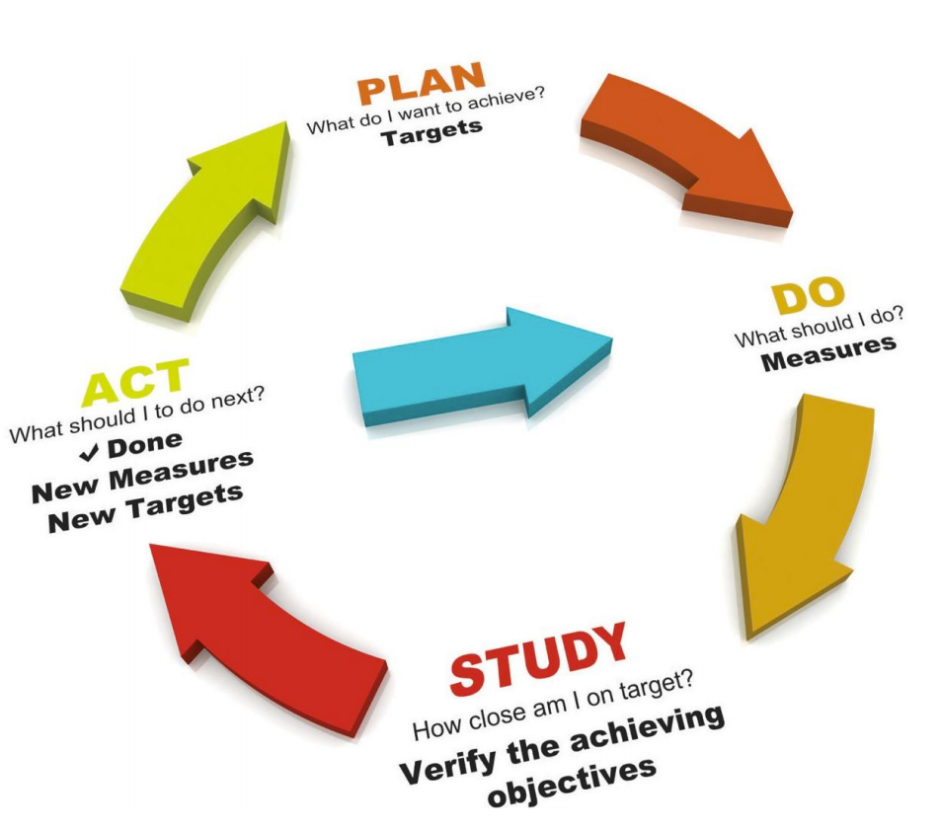
WHAT IS EVALUATION?
The Evaluation process can help you can uncover:
what works and why it has worked;
what hasn’t worked and why;
what has been done for those taking part;
what difference it has made to individuals, targets groups, and of course the wider community;
what has been learned by the community organisation and volunteers;
how the money has been put to good use;
what you would do differently next time.
What are the impacts on the community/region/wider landscape?

Slide 6
NEED FOR EVALUATION
It shows how you have met your project ambition and goals and demonstrates the adequacy, efficacy, effectiveness and efficiency of your community regeneration project. It gives reassurance to those that have invested in you – financially and emotionally.
Shows you are using the resources you raised in a responsible way. Can help convinces stakeholders to sustain their investment
Learning process: evaluation can help prioritise changes in the assessing needs, the planning and implementation of actions and management of resources. If Covid-19 has taught us anything, it is that projects change, priorities change, and as communities, we need to adapt.
Helps change and challenge public attitudes and influence public policy; Supports new or add on projects which may need further funding.

Slide 7
HOW AND WHAT TO EVALUATE?
How the regeneration project has met its objectives of being a catalyst for change in the community?
WHEN TO EVALUATE: Evaluate regularly (during, after) to see how these objectives were reached. Do not wait until the end – the key learning will be lost.
WHO SHOULD BE INVOLVED: Include all who participated in the project – the committee, the end beneficiaries, funders and other public stakeholders.
WHAT: Evaluate to find areas for improvement

Slide 8
TYPICAL OUTCOME EXPERIENCES
Communities have achieved ‘critical mass’ in terms of regeneration activities and are on a self-reinforcing upwards spiral (typically after a lengthy period of support and several false starts),
Communities are very lively in regeneration terms with a range of projects happening and planned, and
Communities which are struggling to capitalise on the regeneration efforts that have been made over the years, or feel they have reached the limits of what might usefully be achieved (the latter are typically quite small communities).
While the road will be rocky, and observable progress slow in the early years, long term funding and support for building regeneration capacity does appear to begin to pay off quite substantially in the medium term.
Shared by The Tavistock Institute https://www.tavinstitute.org/ for The Welsh Development Agency

Slide 9
THE WELSH EXPERIENCE
THE Tavistock Institute completed an assessment of the Community Generation Supports delivered by The Welsh Development Agency.
It assessed experiences of the key team involved –
The Boards/Committees of community regeneration projects
The Boards of the groups have been seen as: “representing community”, “representing organisation”, “bringing in a particular skill”, “an opportunity to make something happen”, and “making people proud of where they live”.
Challenges faced by all Board members was the time it demands (a good full time co-ordinator often makes the difference here) and the complexity of the relationships they have to develop and maintain.

Slide 10
THE WELSH EXPERIENCE
Large, active, enthusiastic and committed Boards, with sub committees for various projects and/or themes, and with a high level of capacity, was often a common factor in achieving the momentum required for ongoing and successful regeneration efforts (though there are examples of quite small, almost executive groups achieving considerable successes).
The ability of the Board and subcommittees to make links with and have representation from other agencies, such as the Local Authority, is key to developing a shared vision and common goals for communities.

Slide 11
THE WELSH EXPERIENCE
Where the community regeneration project had a paid Co-Ordinator.
The role of the co-ordinator is central and is variously described as:
“co-ordinates”, “makes things happen”, “looks for funding”, “keeps things together”, “organises”.
Co-ordinators’ challenges include keeping and knowing their boundaries – ‘what you do and what you don’t do’, service to their Boards, project management, and combating apathy while not raising expectations unduly.

Slide 12
THE WELSH EXPERIENCE
The experiences of External Partners
All groups have an array of partners (often synonymous with funders but not always).
Relationships to partners vary greatly but in practically all cases, groups are seen by these bodies as catalysts for making things happen in the community by bringing various partner organisations together.

Slide 13
THE WELSH EXPERIENCE
The experiences of Community Engagement
Different contexts need to be taken into account but generally the challenges to community engagement included geographical dispersal of settlements in the areas covered, apathy in the community or distrust of change, and specific histories of relationships between the community and the local authority.
The main method of engagement was seen through representation on the Board of different sectors of the community, report on progress through newsletters, open evenings, reports in local papers, and public consultations

Slide 14
THE WELSH EXPERIENCE
Challenges faced by groups have included:
Co-ordinating multiple people, groups and initiatives – most working on a voluntary basis or not under the direct control of the group.
Keeping the momentum going particularly where projects take a long time to come to fruition.
Being diplomatic and politic in the context of communities’ complex dynamics
The inevitable difficulty of not being able to please everybody.
Uncertainty with regards to future core funding and sustainability

Slide 15
SECTION ONE: COMMON BARRIERS TO SUCCESS AND HOW TO OVERCOME THEM
Time delays, budget overruns and conflict can all stop or slow your project success. In this section, we provide some tips for avoiding/overcoming these challenges and more.

Slide 16
THE REALITY – TIME DELAYS
The sheer length of timescale involved in community and economic regeneration must always be remembered. The greatest successes are to be found in the communities which have been engaged in development processes for a longish time (though of course longevity in itself is no guarantee of group success).
Time delays can be significant in some projects, especially those with funding arrangements that require the work/project to be complete by a certain date.

Slide 17
5 TIPS TO AVOID/OVERCOME TIME DELAYS
Once you realize that there is a delay, organize a committee meeting. Inform everyone working on the project about the delay, including details such as factors contributing to the holdup and how far it has set the project back.
Ask for input and ideas on how to get back on schedule and plan a course of action moving forward.
If you will require additional work from committee members or supplementary resources, make this known as well. Asking for volunteers who are willing to take on extra tasks as needed is advisable, as well.
Review tasks assigned to committee members. Prioritize project assignments, moving any that are especially time sensitive to the top of the list.
Scale back on unnecessary tasks. This will not only get you closer to your schedule but also ensure that your committee has the time needed to produce a quality outcome.

Slide 18
BUDGET OVERRUNS
Budget overruns happen when your regeneration projects runs out of money or you uncover new costs during the project development.
Tracking of a project budget in real time will allow you to see in advance whether a project is forecast to go over budget.
If half of the job, 50%, has been completed and 75% of the budget has been spent you are highly likely to be on track to “blow the budget”.

Slide 19
5 TIPS TO AVOID/OVERCOME BUDGET OVERRUNS
Allow for some contingency in the project budget.
Tracking budget at a monthly level is a discipline in terms of keeping informed of your project’s current financial status.
Set the expectation for people working for you at the start of a project that under no circumstances should they be going over budget without you.
Seeking more funding may be a perfectly valid option, particularly if your project changes and is delivering more than was originally anticipated.
Where extra funding cannot be found to cover additional costs there are some ways to still deliver the project. You can do this by reassigning resources to a lower cost resource and/or reducing the project scope. But be mindful of the impact this may have on your timeline.

Slide 20
LACK OF USE/NOT FIT FOR PURPOSE
One of the challenges that can happen to a community regeneration project is for it to be found not fit for purpose and/or not used by those intended.

Slide 21
4 TIPS TO AVOID/OVERCOME LACK OF USE/NOT FIT FOR PURPOSE
The more clearly you define your project’s objectives at the start, the more likely you are to achieve them.
Your committee needs to regularly evaluate the project to ensure that it is fit for its intended purpose and meets a definite need in your community
Don’t assume the need is there in your community. Just because you think the project is a good idea, it doesn’t mean everyone else will. This is why getting wide community buy in from the start is key. Revert back to Module 2 Finding the right opportunity for your community – useful exercises and templates
Design your projects with some degree of flexibility – overtime as the needs of your community change, can your project change, grow or evolves to suit those needs?

Slide 22
COMMUNITY COMMITTEE PROBLEMS OR CONFLICTS
Conflict is both normal and inevitable where a group of people are trying to achieve something. It may be a sign that relationships have not been developed or maintained well. The important thing is how conflict is dealt with. If it’s addressed constructively, conflict can be an important step in building and maintaining relationships. Conflict may arise due to:
Diversity and difference in values, opinions, culture, needs and perceptions.
Power imbalances.
Suppression of feelings and emotions.

Slide 23
5 TIPS TO AVOID/OVERCOME COMMUNITY COMMITTEE PROBLEMS OR CONFLICTS
People often talk about what’s annoying them outside of the group, rather than at meetings. Providing a time for people to speak when the group is together can be helpful.
When people are in conflict and not dealing with it, the energy of the group will often be sluggish. Check out what’s happening if you sense an energy loss. Try revisiting the group’s purpose. Have people temporarily forgotten what they are there for or are people working towards different goals?
If the conflict has become too big, it’s sometimes best to stop the meeting. Conflict might be better dealt with just between the people concerned or using an outside facilitator.
People often bring things up that are irrelevant to the purpose but still important to them. Use a ‘parking lot’ piece of paper for these issues - this lets people know they aren’t forgotten. The issues can then be dealt with either after the meeting or at the end. If the issue is big enough, consider calling another meeting to deal with it.

Slide 24
PROJECT IS NOT SUSTAINABLE
If your community regeneration project is not sustainable it has a very limited future. Sustainable development is a process which all communities should strive towards.
As we learned in modules 1 and 2, it is a process which addresses the community's current and future needs for long-term, sustainable development that is not going to compromise later generations.

Slide 25
4 TIPS TO AVOID/OVERCOME UNSUSTAINABLE PROJECTS
Sustainability can be mishandled and have the opposite effect of what was originally intended. It is important communities thoroughly research and educate themselves about what sustainable practices are going to work best in their situation.
Step back and look at the way your project connects with the mission, vision and value of your local/national/European government agendas (e.g. in Module 2 we introduce you to the UN’s Sustainable Development Goals). By aligning to these, you can embed sustainability into your project.
Set up your project with quality in mind. Meet with stakeholders to discuss what sustainability means in terms of quality deliverables practically and in terms of risk.
Carefully construct your project ideas so that they addresses the community's current but don’t compromise later generations.

Slide 26
SECTION TWO: SUSTAINING SUCCESS – THE ROLE OF YOUNG PEOPLE AND VOLUNTEERS
Why empowering and engaging the young people and volunteers in your community is important?

Slide 28
The Role of Youth in Community Regeneration
Development academics, researchers, and community leaders agree that involving youth in addressing issues that affect them has tremendous potential for social change.
Young people bring many assets to community-building work, which too often are overlooked, not valued or leveraged. Communities should have varied avenues for a wide diversity of young people’s voices to be heard and for youth to contribute to a thriving community.
Sustainable youth engagement can come when communities create more support for youth voices to ensure that community-decision-making is informed by a wide range of youth—especially those directly impacted by community change.
Youth Activism and Community Change | CIRCLE (tufts.edu)

Slide 29
The type of youth engagement you don’t want…
Imagine this scene, played out frequently by community groups with the best intentions for youth:
A meeting table is surrounded mainly by adults with one or two youth at the table. The youth at the meeting have been tasked with the responsibility of being representatives on the board. Because they value youth perspectives, the adults feel good about including them. The conversation, while important to the work of the group, is clearly not resonating with the youth, who do their best to appear engaged and interested. As the discourse continues the youth rarely speak up, and when they do, they are cut off or not fully understood by the adults running the meeting.
At the end of the meeting the youth are unclear about the role they actually played. The adults feel satisfied, knowing they have included the voice of youth, thus demonstrating their commitment to youth development in their community. Is this satisfactory ?
Youth Community Engagement: A Recipe for Success – JCES (ua.edu)

Slide 30
8 Ways Young People can be encouraged to engage in community regeneration and development
1. YOUTH SERVICE: volunteerism, community service, and service learning.
2. YOUTH LEADERSHIP: often developmental in nature, helping youth acquire skills to understand and address issues affecting them.
3. YOUTH DECISION MAKING: youth in governance or other roles that lead to decision making in a community.
4. YOUTH PHILANTHROPY: giving of one’s time and resources for the benefit of others.
5. YOUTH POLITICAL ENGAGEMENT: youth in civic and political affairs.
6. YOUTH ORGANIZING: community organizing and advocacy.
7. YOUTH MEDIA: developed and disseminated by youth.
8. YOUTH EVALUATION AND RESEARCH: youth in systematic inquiry into issues that affect them and their communities.

Slide 31
TOP TIPS TO ENGAGE YOUTH IN COMMUNITY REGENERATION
Create opportunities for youth members co-lead meetings and provide frequent and thoughtful contributions to the conversations and co-design the regeneration projects that will shape their futures
Youth need to feel that their efforts are valued and make a difference or they are likely to fall away from youth-adult partnerships
Adults provide youth with encouragement and support, and in the best cases, gradually allow youth to take more and more active leadership in the programs that serve them
Create opportunities for youth and adults to research, discuss, and evaluate real concerns that matter to them and their community and create an action plan for change.

Slide 32
The Role of Volunteers in Community Development
According to the UN, volunteerism strengthens civic engagement, safeguards social inclusion, deepens solidarity and solidifies ownership of development results. It tells us that volunteering has a ripple effect and that it inspires others and advances the transformations required for the SDGs to take root in communities.
By its very nature, volunteerism is an important vehicle for sustainable development. Volunteerism lets people and communities participate in their own growth. Through volunteering, citizens build their resilience, enhance their knowledge base and gain a sense of responsibility for their own community.
Volunteerism and the Global Goals | UNV
This Photo by Unknown Author is licensed under CC BY-SA

Slide 33
Consider training your volunteers – it will yield rewards.
“The value of training is directly proportional to the effort which management puts into it. Whether you have only a few volunteers, or are entirely dependent upon them, if you don't train them then the organisation will inevitably suffer in the long run”.
- Lisa Conway, Working with volunteers

Slide 34
TYPES OF VOLUNTEER TRAINING
Training of volunteers comes in many guises. It may be done in-house, externally, or jointly with other organisations or community groups, and includes:
It is recommended that a variety of techniques are used, which combine listening, discussing, observing and doing, as this will help to maintain attention and interest.
on-the-job training
practical demonstrations
work shadowing
buddying/mentoring systems
visiting other organisations
inviting outside organisations in workshops, lectures, seminars etc
attending conferences
role plays and simulations and problem-solving exercises
group discussions
speakers and films at meetings
once-off training sessions
distance learning

Slide 35
Consider training your volunteers – it will yield rewards.
Training lessens the likelihood of mistakes and other problems and minimises risk (for example, health and safety training)
It demonstrates that your committee believes in a high standard of work
Some organisations use training courses as a part of their volunteer selection procedure
Training can heighten personal skills and awareness, so the volunteers can function more effectively as individuals and therefore do their voluntary work more successfully
It can also improve interpersonal and group awareness, so volunteers can both work more effectively

Slide 36
NOTE!
Some volunteers value the provision of training enormously, regarding it as an essential part and tangible benefit of their volunteering experience, and looks great on their CVs.
In these cases, training will undoubtedly increase volunteer confidence and satisfaction. However, others may not see the need for training, or even if they do, they may find the idea very off-putting (possibly because it reminds them of unhappy school days).
If this is the case, the need for training must be 'sold' with great sensitivity. In all instances, training must be well-planned and appropriate to the needs of organisation and to the needs of the individual volunteer.

Slide 37
ISSUES TO CONSIDER
It can be sometimes helpful to develop an overall training policy for your community group/committee which includes volunteer training; alternatively, tackle the issue of volunteer training in your volunteer policy (including topics such as identifying training needs, eligibility, etc)
Increasing attention is now being paid to accreditation of volunteer training. If your volunteers are expected to complete a major training programme, this is well worth investigating.
Always make sure any volunteer training is closely monitored and evaluated. There is no point devoting resources to something which is not proving worthwhile.

Slide 38
Recognition of Community Volunteers
Given the contributions that volunteers make to your community and the imperative to encourage even greater participation by citizens in the community, formal recognition of positive actions for the betterment of society must be widely valued and recognised.
It is about respect and value for all of the ways that people are prepared to give their time.
In celebrating volunteerism, it is important also to pay tribute to informal contributions, as these types of participation are often overlooked.
Nominating community volunteers for awards is a nice way to give them recognition. See Section 3 of this module for some links to awards

Slide 39
SECTION THREE: CELEBRATING, SHARING AND RECOGNISING YOUR SUCCESS
Innovative marketing techniques and approaches to promote your community regeneration work and projects and attract more interest in them

Slide 40
Why should your community group celebrate its successes?
Community regeneration projects are hard work. It’s work that done in your spare/free time (late evenings and weekends) and unlike your job/career it doesn’t come with personal financial rewards. Rewards come instead from the positive impact the work you/your committee leaves on the community and it is very important to celebrate and share your successes, milestones and achievements.
Celebrating success is a valuable routine to get into with your community which can help boost morale and productivity, as well as giving your volunteers an incentive to get involved again or stay involved!
A success doesn’t have to be a major achievement or one big project. Success might be that small but concrete step you and the community has made towards a long-term goal.

Slide 41
CELEBRATING, SHARING AND RECOGNISING YOUR SUCCESS
Video Blogs
Video blogs—usually housed on the YouTube platform or other social media —serve as video-based diaries and they are a great tool for community groups to record and share your community regeneration successes. Video is a really powerful communication tool.. Did you know:
Facebook generates 8 billion video views per day on average
YouTube reports that mobile video consumption is rising by 100% every year
55% of people watch videos online every day

Slide 42
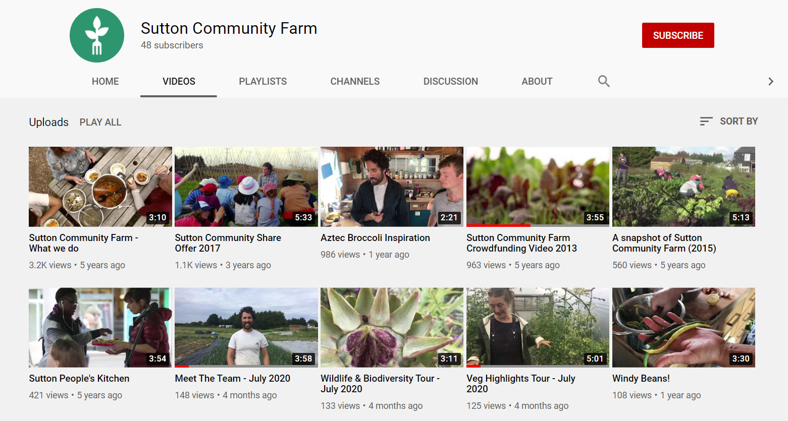
Sutton Community Farm who we met in Module 5 use video blogs to great effect to introduce their team, showcase and celebrate what they do and ultimately grow their community even further. Have a look at: Sutton Community Farm - YouTube

Slide 43
CELEBRATING, SHARING AND RECOGNISING YOUR SUCCESS
Infographics for Impact
Infographics are a nice tool which you can use to quickly, precisely, and clearly convey a complex topic such as the impact (either potential or proven) that your community regeneration project has or will have. Infographics can help tell an impressive community regeneration story by via captivating, memorable imagery.
Thanks to some very simple tools like Canva for example, you can easily create a custom infographic for your community regeneration project with just a few clicks.
See resource pack for more info on Canva.

Slide 44
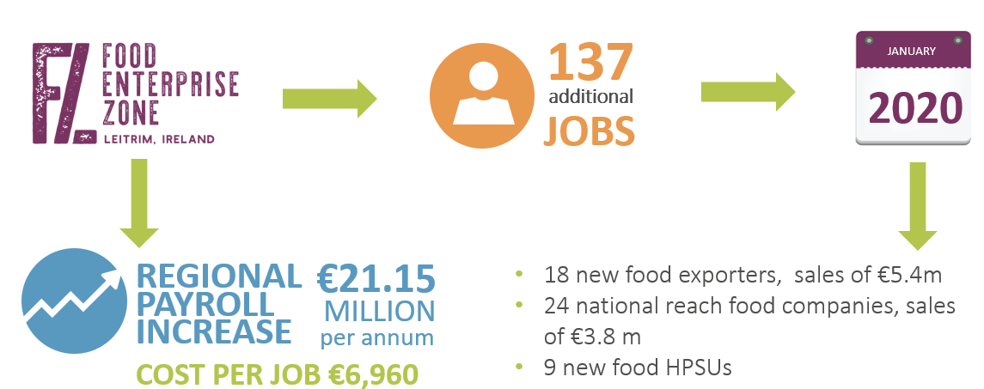
Infographics for Impact – some examples:
Infographics (like the two examples above) are a great way to quickly and easily share the impact of your community regeneration projects.

Slide 45
CELEBRATING, SHARING AND RECOGNISING YOUR SUCCESS
Local/Regional Media
It is always a great idea to pitch your community regeneration story to your local media (press/radio). You can even do this more than once during the lifetime of the project.
Start with a press release to announce the project and or fundraising campaign and then draft a second one once the project is complete with details the project completion, launch and impact/benefits the project is having on the community.

Slide 46
Local and Regional Newspapers are always looking for good news stories that are relevant to their readers. What could be more relevant than local community regeneration projects?!

Slide 47
Entering Community Awards is excellent way to help your community get recognised for its successes
Pride of Place Awards - Ireland
Pride of Place is an all-island competition that acknowledges and celebrates the work that communities are doing all over the island of Ireland. The competition focus is about people coming together to shape, change and improve daily lives in their communities. All categories population categories, single issue theme categories (Creative Place Initiative, Community Wellbeing Initiative & Community Tourism Initiative) as well as Housing Estates, Islands and Coastal Communities and Urban Neighbourhoods.
Home - IPB Pride of Place Awards

Slide 48
In 2020, Kilmuckridge won the Pride of Place Islands and Coastal Communities award for its many projects successfully undertaken and delivered by a very effective community group working for the good of the local population.

Slide 49
Entering Community Awards is a great way to help your community get recognised for its successes
Volunteer Ireland Award - Ireland
The Volunteer Ireland awards aim to celebrate and recognise the thousands of volunteers across Ireland who give their time and talent to benefit others. The Volunteer Ireland Awards are open to people of all ages volunteering with Irish volunteer involving organisations.
Volunteer Ireland has 11 award categories – Community, Animals and Environment, Arts, Culture and Media, Campaigning and Awareness Raising, Children and Youth, Safety & Emergency Services, Health and Disability, Social Work & Social Inclusion, Sports and Recreation, Outstanding Group Award and Outstanding Volunteer Manager.
About the Awards Categories – Volunteer Ireland

Slide 50
Entering Community Awards is a great way to help your community get recognised for its successes
Community Hero Award - Ireland
The Community Hero Award is a lifetime achievement award honouring a volunteer who has – over the course of their life – made an extraordinary contribution to a good cause. This award is a unique collaboration between the Volunteer Ireland Awards and The Wheel’s Charity Impact Awards. It aims to shine a light on those remarkable individuals who, year after year, dedicate their time and energy to supporting a community and voluntary organisation, club or association. Community Hero Award – Charity Impact Awards

Slide 51
Entering Community Awards is a great way to help your community get recognised for its successes
British Citizen Awards for Community - UK
The Community Hero Award is a lifetime achievement award honouring a volunteer who has – over the course of their life – made an extraordinary contribution to a good cause. This award is a unique collaboration between the Volunteer Ireland Awards and The Wheel’s Charity Impact Awards. It aims to shine a light on those remarkable individuals who, year after year, dedicate their time and energy to supporting a community and voluntary organisation, club or association. Community Hero Award – Charity Impact Awards

Slide 52
SECTION FOUR: PLANNING FOR THE FUTURE
How to build on your success and reshape your community regeneration projects for a post COVID world

Slide 53
Can a crisis become an opportunity when planning for the future?
After the shakeup of Covid-19, many community regeneration projects have gone into crisis and survival mode. But now is also the time to be thinking about the future and recovery phase.
In the coming years, there will be new needs from our communities, and a need to reimagine existing community services and projects are reimagined. There will also be more open space for community business models with purpose.
Our economy needs strong community groups and bottom up regeneration now more than ever.

Slide 54
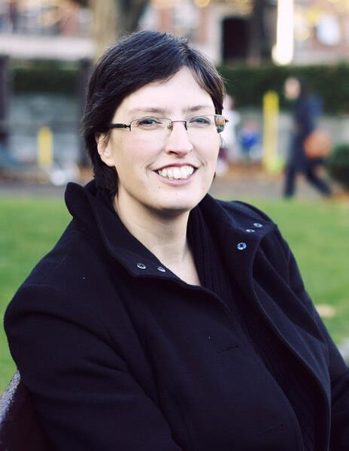
KEY INSIGHTS
Can a crisis become an opportunity?
“Like so many grassroots charities and social enterprises, we’ve been battling to survive in the face of a crisis that wiped out income streams and imposed challenges that even the most forward thinking had never fully anticipated. I am suggesting we take a deep breath… and begin a conversation around the same simple questions that launched The Exchange in the first place.
“Is there a better way? Can all of us together find solutions that an individual or single group could not even dream of?” It’s time to imagine and re-imagine, to dream dreams, to remember old ideas and to embrace new ones. This is a time to make new connections and to sharpen our impact with dynamic collaborations. This is a time when caring and resilient communities come into their own and when the strength of social capital shines brightly.”
Ruth Garvey-Williams is one of the founding members of The Exchange (www.exchangeinishowen.ie) an award-winning voluntary-run community centre and registered charity committed to innovating creative projects to benefit their community.

Slide 55
Build Community Wellbeing into your regeneration plans/projects
Community wellbeing is influenced by many factors - social, economic, environmental, cultural, and political. COVID19 induced social isolation and loneliness have impacted on wellbeing for many. A range of factors may be drivers of poor mental health, including those directly related to COVID-19 (e.g. more generally or because of the loss of family and friends to COVID-19) and those indirectly related through the effects of the social distancing and lockdown measures (e.g. through social isolation or because of financial insecurity)
In the years to come project which build and promote Community Wellbeing will be key.

Slide 56
EXAMPLES - Promote and Facilitate Opportunities for Community Play and Recreation
Covid-19 restrictions have changed the way children play and this change could impact long-term health and wellbeing concerns such as activity levels and socialization. Engaging in a range of play activities is central to children's development, learning, health and happiness.
Post pandemic, communities should try to prioritise children's right and need to play.
Could now be a good time to review or upgrade the play spaces in your community?

Slide 57
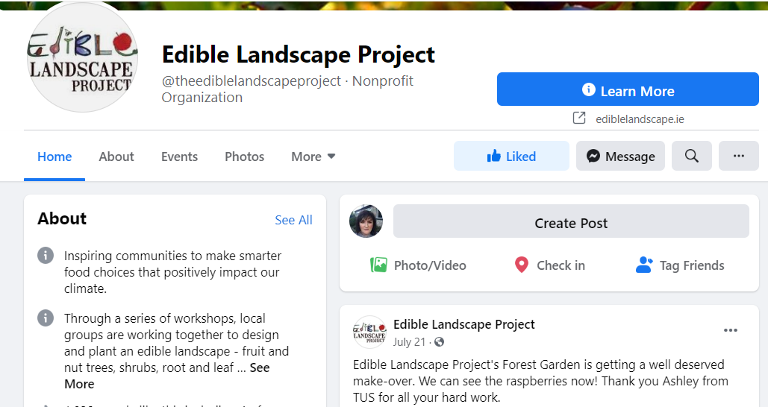
EXAMPLES – Greater connection to nature and the protection of our environment
Increased community role in biodiversity and climate change – you are ideal ‘test beds’ for innovative practices to equip citizens to develop a set of competences to fully engage in environmental protection, climate change and responsible consumption.
The Edible Landscape Project (ELP), is a pan-European movement, based from Westport, County Mayo, Ireland. They empower individuals and communities to take care of nature and protect the planet by building local food security and climate resilience.
https://ediblelandscape.ie

Slide 58
Time to embrace technology – what does the future of work look like?
For countless businesses, remote working practices will be part of their new norm, and there is an opportunity for local community and regional hubs to be (re)developed and positioned to provide structured, well connected, professional working environments, that are potentially less expensive than the equivalent area of office space.
In terms of sustainable development and the regeneration of local communities, the future of work will not just be centred on a new place to work but rather the creation of local and regional ecosystems and enterprise clusters that can innovate and collaborate quickly.
And there are benefits across the board. A proliferation of particularly rural digital working spaces could help living more affordable and will mean less commuting for more and more professionals.

Slide 59
Technology and the future of work is a key interest for Irish local government
Spotlight on DIGICLARE – a local government initiative to connect rural communities
Digiclare is an innovative initiative of Clare County Council, Ireland as part of its Rural Development Strategy to support rural communities by providing flexible, affordable and local office facilities and high-speed broadband connectivity in rural locations in County Clare. The project was founded as a key action of the ‘Clare Digital Strategy’ that provides for what are called ‘Intelligent Communities’ that ensure local people as well as enterprises and entrepreneurs have access to high speed broadband in their own community.
The DIGICLARE hubs experienced a “huge surge” in demand for desk space during the summer of 2020 and since then the prospect of opening student hubs in the county for third-level students is being explored. This innovative project is adapting to current and future need and pivoting for sustained success. The digital hubs are in Ennistymon, Kilrush, Kilkee, Feakle and Miltown Malbay a
DIGICLARE - Connecting communities
CASE STUDY

Slide 60
Having lived in Dublin, Cork, Galway and parts of England, Lorna says rural Ireland is her preferred base. “My ancestral roots are from Connemara, but I grew up in Tulla, Co Clare and now I’m living in east Clare. I like the quality of life in rural Ireland. Places such as the DIGICLARE Feakle Digital Hub make it easier to choose rural Ireland.”

Slide 61
Diversity, Inclusion, and Belonging
The future of communities is inclusive
Inclusion means inviting diverse groups to take part in community life.
It's belonging that makes each individual feel accepted for who they are.

Slide 62
Sustaining Success and Future Planning – useful exercises and templates
Key Action Pack 6
Developing Youth and Adult Partnerships – Brainstorm Activity
Canva Infographic Tool
These exercises will help you to build on the momentum and success you have achieved and plan for the future of your community.

Slide 63
1. Developing Youth and Adult Partnerships – Brainstorm activity
The idea of this activity is to ask youth and adults to brainstorm the benefits and challenges of working together. Each group (youth or adults) then take turns sharing their thoughts by posting the benefits and challenges on the wall.
Adults are usually very frank in their assessments, saying youth are “overcommitted” and “impractical.” Likewise, youth will often say the adults are “too rigid” and “old-fashioned.” But the adults are also likely to comment on the youth’s creativity and enthusiasm, while the youth will recognize adults for their wisdom and experience.
This is a great exercise to get a discussion going and break down the barriers and different viewpoints between the varying age groups.

Slide 64
2. Canva Infographic Tool
Canva's infographic maker is the non-designer's secret weapon.
Canva is a graphic design platform which you can use to create infographics, social media graphics, presentations, posters, documents and other visual content to promote your community regeneration projects.
Home - Canva

Slide 65
Key references for Module 6

