Slide 1
Module 3 Placemaking – A Powerful Tool for Community Regeneration
www.restart.how
This programme has been funded with support from the European Commission
This project has been funded with support from the European Commission. This publication [communication] reflects the views only of the author, and the Commission cannot be held responsible for any use, which may be made of the information contained therein.

Slide 2
Intro
Placemaking – a Transformative Process for Community Regeneration
MODULE 3 OVERVIEW
01
Standard Placemaking - creating places that people want to live, work, play and learn in
In this module, we explore placemaking as a process for community regeneration.
We focus in detail on the four main types of placemaking and hone in on how each one works. We look at some great real life applications of these in communities.
In the final section, we provide you with a pack of useful exercises and templates to help you start using placemaking in the planning of your new regeneration project/s!
02
Strategic Placemaking – the use of placemaking to achieve a particular goal or specific purpose
03
Creative Placemaking – using the arts and cultural activities to shape the physical and social character of your community around
04
Tactical Placemaking – testing permanent placemaking ideas with demonstrations and pilot programmes
KEY ACTION PACK 3:
Useful exercises and templates to start apply placemaking approach to your community regeneration project

Slide 3
INTRO: Placemaking – a Transformative Process for Community Regeneration
What is Placemaking and what role does it play in economic, social, environmental regeneration and sustainability?

Slide 4
Placemaking - A Community Regeneration Process
Placemaking is both a philosophy and a practical process to collectively transform, reimagine and reinvent public spaces. It is centered on observing, listening to, and asking questions of the people who live, work, and play in a particular space in order to understand their needs and aspirations for that space and for their community as a whole.
Placemaking is a powerful community regeneration tool which communities can use to get back in control of their future and their environment.
Placemaking is fundamentally about inclusion and shared community ownership.

Slide 6
Placemaking is…
a process that capitalises on a communities assets, inspiration and potential
particularly attentive to the physical, cultural and social identities that define a place – it’s DNA
a multi-faceted and dynamic approach to the planning, design and development of places and spaces
a philosophy and ongoing process, we never reach a “placemade” state, we are always placemaking

Slide 7
The Placemaking Process
The essence of placemaking is action at a hyperlocal level. Placemaking is an effort to strengthen the connection between people and the places they share, through the reimagination and reinvention of their communal spaces.
The Placemaking process is a bottom-up approach that draws on the assets and skills of a community.*
When it comes to placemaking, there is no one size fits all approach. Each place, each community, is unique and each needs to find the tools and approaches that work for them.
* Our Module 1 exercises helped you assess the assets and skills of your community, if you didn’t complete these exercises yet, now would also be a good time

Slide 8
Who is involved in the Placemaking Process?
COMMUNITIES OF LOCAL ACTIVE CITIZENS
Placemaking is a community-led process which employs the creativity of people and facilitates community participation, social inclusion, place analysis and experimentation (i.e. try-out of ideas to improve a public space) as well as the animation of a place (e.g. events and activities of people to creatively use public spaces).
EXTERNAL STAKEHOLDERS
This group provide external placemaking support (funders, local council, placemaking experts and professionals).

Slide 9
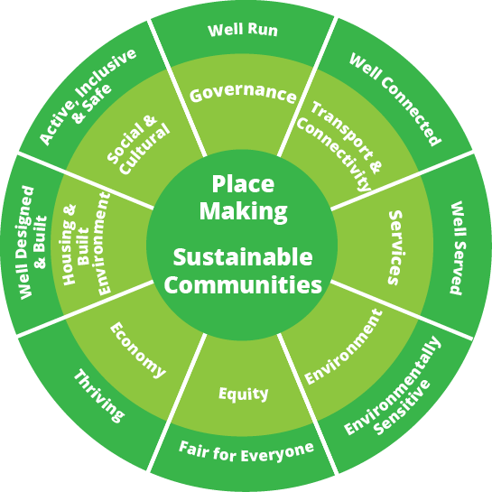
Placemaking and Sustainable Communities
This diagram demonstrates why placemaking and sustainable communities should be at the centre of our regeneration thinking.
It highlights the regeneration characteristics (many of which we have already come across in Module 1 and 2) which make for good placemaking and sustainable communities.
Source

Slide 10
Role of Placemaking in Economic Regeneration
The concept of placemaking is critical from the perspective of enterprise and wider economic development.
Creating vibrant, attractive places to live can enable key economic conditions such as attracting and retaining talent!
Economic development as we have learned is critical to improving local quality of life as well as quality of the environment.

Slide 11
Role of Placemaking in Social Regeneration
The concept of placemaking is critical from the perspective of enterprise and wider economic development.
Creating vibrant, attractive places to live can enable key economic conditions such as attracting and retaining talent!
Economic development as we have learned is critical to improving local quality of life as well as quality of the environment.

Slide 12
Role of Placemaking in Environmental Regeneration
Environmental sustainability can’t be achieved without placemaking and addressing people’s inherent needs for a sense of community.
We can try to outsource our problems to a new generation of green engineers, designers and architects, but will only see broad, lasting changes when the people inhabiting these communities create a vision for the future and lead the process for change.

Slide 13
How the Placemaking Process typically works..
The community begins with small placemaking projects and builds each subsequent project on the last successful one
The community prioritizes its efforts and does not try to do everything at once
The community seizes emerging opportunities when it makes sense to do so
The community uses specialized forms of placemaking to achieve those objectives that each form is best suited to achieve
Placemaking is action-oriented so steps are followed to bring the project to life. It is not just thinking about doing something, it is acting upon what is thought about.

Slide 14
NB: The Power of Ten in Placemaking
The Power of 10 is a super simple but excellent rule of thumb to follow in placemaking.
So what is the Power of 10?
Places thrive when there are at least 10 things to do, arranged in such a way as to create social linkages. Scaling this up, a specific destination or neighbourhood needs at least 10 places, that offer people a reason to visit and spend time there. One more level up, a city needs at least 10 major destinations, creating a powerful network of a thousand things to do. Does your community have the power of 10? There’s a Power of 10 challenge at the end of this module.
Source
This Photo by Unknown Author is licensed under CC BY-NC

Slide 15
TYPES OF PLACEMAKING
There are four main types of placemaking. All focus on creating an authentic sense of place, but differ in how they achieve those results.
Knowing the different types of placemaking strategies will help you as local leaders to choose the correct method for your community.
So let’s take a look..
Section One: Standard Placemaking
Section Two: Strategic Placemaking
Section Three: Creative Placemaking
Section Four: Tactical Placemaking

Slide 16
SECTION ONE: Standard Placemaking
Standard Placemaking is the process of creating Quality Places that people want to live, work, play and learn in.

Slide 17
Standard Placemaking
In this form, placemaking can be used for many different purposes. For the most part placemaking is used as an incremental way to improve the quality of a place over a long period of time with many separate small projects and/or activities.
Placemaking puts people at the heart of the community planning process and it promotes a very simple principle with regard to the planning of public spaces.
Source

Slide 18
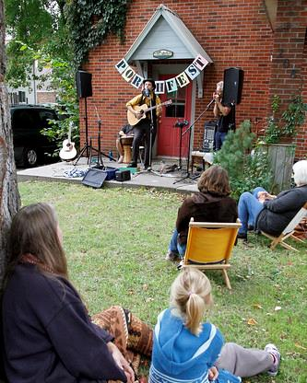
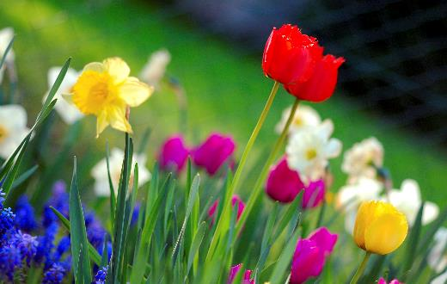
STANDARD PLACEMAKING IDEA
Porch Placemaking – a simple but powerful way for socially distanced communities to connect in 2020 and beyond
Porch placemaking week ran from 30th of May to the 5th of June 2020 and was enabled by a network of self-organised projects around the world.
In 2020, Covid19 led to people being physically distant and a need to find new ways for communities to be socially connected.
Porch placemaking is a simple idea that encourages placemaking action and bringing people together (from a safe distance) with simple activities on balconies, in front yards, driveways and porches. Porch Placemaking activities can include simple actions like planting flowers, painting your gate or more elaborate activities like holding a Porch Fest for neighbours.
Source
This Photo by Unknown Author is licensed under CC BY-SA

Slide 19
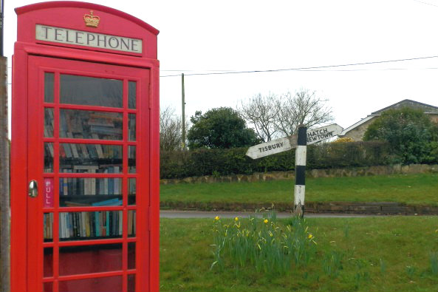
STANDARD PLACEMAKING IDEA
Community Street/Miniature Libraries
Miniature free libraries are popping up in communities all over Europe in hotels, train stations, schools and even in old telephone boxes.
The miniature libraries are typically made of wood with glass cases that can be opened; users take a book and bring a book. These little libraries are a simple idea but are a powerful one that can create a sense of community and place.
They invite your neighbours to share the joys of reading and can create lasting connections inside your community.
Adopt a Phone Booth Library With mobile phones taking over, there seems little need for phone booths anymore, but rather than get rid of the iconic red booths in the UK, local communities are using them for new purposes. British Telecom is encouraging towns to turn their phone booths into mini libraries and so far hundreds of communities have transformed their telephone box. If your community's phone booth sits empty, learn how to make one over here into your very own local lending library
Source

Slide 20
A disused Phone Box in Westmeath, Ireland – is converted into a community resource
In Ballinahown, Westmeath, a quirky library in an old phone box is such an attraction locals have their wedding photos taken beside it.
“A few years ago, we rescued our phone box when it was being removed and then the nearest library to us were doing a clear-out and I’d an idea we could start a library in the phone box,” says artist, Helen Conneely, who is involved in the Tidy Towns initiative.
“In the Tidy Towns, they award extra points for sustainability and upcycling. The idea is to make something out of nothing and to do it creatively, so even the shelves in the box are made from fencing” says Helen.
Read More: Irish Examiner Article - Public spreads the word on novel little libraries
CASE STUDY

Slide 21
Standard Placemaking of Natural areas
Natural areas are often characterized as being places that help “restore the soul” of those who visit there. A walk in the woods, mushroom hunting, or fishing can be exhilarating, and puts suburban and urban areas into a different perspective.
A sample of Standard Placemaking projects concerning Natural Areas might are providing access to nature that does not harm it, educational displays that help people learn about the characteristics and value of these natural areas, well-designed and convenient boat, canoe, or kayak launching and fishing facilities etc.

Slide 22
“Stairway to Heaven” wooden walk that protects the nature underneath – Cavan, Ireland
A wooden walkway at Cuilcagh Mountain in County Fermanagh nicknamed the 'stairway to heaven’ opened in 2015 with an aim of conserving pristine blanket bog and restoring damaged peatland that had been eroded by people walking through it.
Prior to it being constructed, the number of walkers in the area was below 3000 annually, but thanks to the popularity of the boardwalk, this figure rose to 60,000 annually.
The habitat on Cuilcagh Mountain is very sensitive to the footfall of walkers and the boardwalk was constructed to prevent walkers from damaging the protected blanket bog. It is important to stay on the designated path in order to protect this beautiful habitat for future generations.
FIND OUT MORE: Cuilcagh Way Walking Routes
CASE STUDY

Slide 23
Standard Placemaking of Rural Areas
Placemaking of Rural Areas looks at that with regard to farming and forestry and is built upon the unique attributes of the growing lands.
Sample of Standard Placemaking projects to promote local farming and forestry might be the development of farmers markets, community run farm or rural life attractions, agriculture festivals or local hiking/walking/biking routes.

Slide 24
Boyle Farmers Market, a community-based market in Roscommon, Ireland
Boyle Farmers Market located in the sheltered courtyard grounds of King House, Boyle, takes place every Saturday from 10am to 2pm.
“It has proven to be one of the success stories of the North-West" as stated in The Bridgestone Irish Food Guide.
The Bridgestone Award winning Farmer's Market in Boyle provides an excellent range of local, fresh, wholesome and healthy produce, including vegetables that are in season, organic meat & poultry, home bakes, fruit juices, jams, sauces, gluten & wheat free breads and fresh fish, to name just a few.
Minimal food miles for these products mean you are reducing your carbon footprint, as well as eating healthily by choosing local food in season.
FIND OUT MORE: https://www.facebook.com/BoyleMarket/
CASE STUDY

Slide 25
Standard Placemaking of Urban Areas
Placemaking has huge role to play in the planning and development of Urban Areas. If you plan cities for cars and traffic, you get cars and traffic. If you plan for people and places, you get people and places. As community makers and regenerators, it is important to know that we have the ability to make different choices — starting for example with the decision to design our streets as comfortable and safe places — for people on foot, not people in cars.
Sample of Standard Placemaking projects in Urban Areas can include Street and façade improvements to buildings, park improvements or other small scale multi-use projects.

Slide 26
Walkability is a top priority in London, UK
The City of London has some of the highest pedestrian concentrations in the world, with 51% of people moving on foot in just 9% of the road space.
Added to that are huge numbers of people on bicycles – the City’s largest transport mode during the morning peak.
London is making great strives to make the city even more walkable.
The City of London Corporation recently banned all but buses, bicycles and pedestrians on weekdays from its notorious dangerous Bank junction (pictured above) – the site of 107 casualties including two deaths between 2012 and 2016.
FIND OUT MORE: What would a truly walkable city look like
CASE STUDY

Slide 27
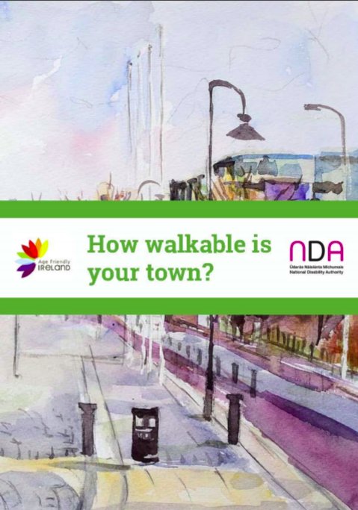
Walkability – an approach and practice that is good for everyone!
The design of a community’s built environment can often become the determining factor between a healthy and active lifestyle or one characterised by limited mobility and high levels of social isolation.
Walkability is a measure of how friendly an area is to walking. Walkability has health, environmental, and economic benefits.
Walkability takes into consideration the design of roads and streets, maintenance of footpaths, crossing points, parking, the general environment of the streets and towns and accessibility of public Spaces and buildings.
Good Walkability in our communities, towns and cities is key to ensuring that people can get out and about in their local area and participate in all their community has to offer.
Click to read this report by Age Friendly Ireland and the Centre for Excellence in Universal Design on the results of Walkability Audits conducted in Ireland in 2014

Slide 28
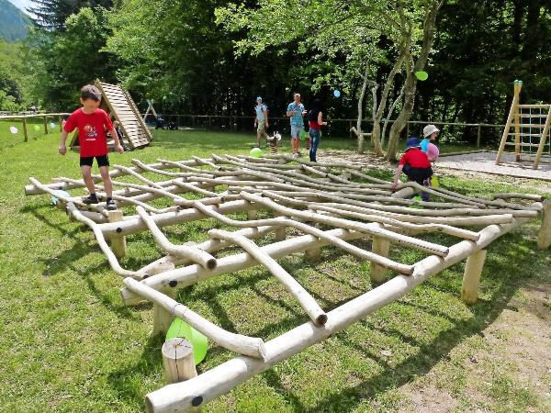
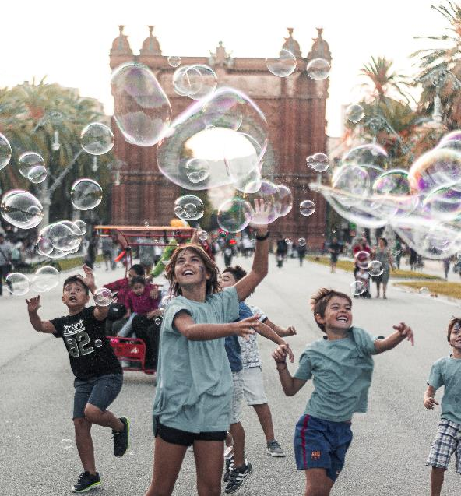
STANDARD PLACEMAKING IDEA
Playmaking – making places for play in our public spaces
Play is a very serious business for young people. It’s intrinsic to a healthy childhood as high-quality play offers a route to fitness that is fun.
For families, safe play spaces offers a safe location for meeting with friends. Perhaps most of all, a well designed play space helps make young people happy in, and with, their local neighbourhoods.
Best practices in playmaking and placemaking, bring the children of the community into the play/placemaking process.
Let’s take a look at some ways you can integrate playmaking into your placemaking process and meet some communities who have taken some very interesting approaches..

Slide 29
This video introduces the Ballyfermot Play and Skate Park which was developed by the Irish Architecture Foundation in collaboration with The Matheson Foundation and Dublin City Council using a People First Design Process. It is a great example of a social regeneration project with Placemaking at its heart.

Slide 30
7 Top Tips in Playmaking
Design play areas which enhance and fit with its setting
Locate play areas in places children would naturally play
Design with nature in mind - grassy mounds, planting, logs and boulders
Designed so that children can play in different ways
Design it so children of all ages and with different abilities can play together - good play spaces avoid segregating children
Designed to enable children to stretch and challenge themselves in every way
Flexible and able to evolve as the children grow — add some ‘slack space’ into the layout — areas with no predefined function — can help introduce the potential for change and evolution.

Slide 31
Play happens everywhere in Vauban, Germany
There is an increasing realisation that play does not just take place in designated play spaces, but in the whole environment that a child occupies. For example, providing a fenced-off play space in the middle of a housing estate is not adequate — the whole estate should be playable. Vauban, an ‘eco-district’ on the edge of Freiburg in Germany, has achieved this.
The neighbourhood is practically car-free. There are some roads, with a 5km/h speed limit — but the majority of the outside space is given over to green, child-friendly playable space. There are no set play areas: play happens everywhere. There is a sandpit here, a climbing rock there, and a swing hidden behind trees. By removing the boundary between garden/ street/park/play area, children have a far wider choice of spaces in which to play.
FIND OUT MORE: Designing and planning for play
CASE STUDY

Slide 32
KEY TAKEAWAYS IN STANDARD PLACEMAKING
Consider how you can reclaim your communities streets as places for people in a variety of ways – economically, environmentally, as well as socially.
Create community spaces and assets that bring together people from all walks of life and all income groups. Your community spaces should be open, safe and welcoming for all
Include your community in the design - only with full public participation in the creation of public spaces can truly great places come into being

Slide 33
SECTION TWO: Strategic Placemaking
Strategic Placemaking is targeted to achieving a particular goal or specific purpose in addition to creating Quality Places.

Slide 34
Strategic Placemaking
Strategic Placemaking aims to create Quality Places that are uniquely attractive to talented workers so that they want to be there and live there, and by so doing, they create the circumstances for substantial job creation and economic growth.
Projects: Mixed-use developments, green pathways to parks and waterfronts, or other entertainment facilities and places for social gatherings
Activities: Cyclical events targeted to talented workers along with other arts, cultural, entertainment and recreational amenities that attract a wide range of users.
Source

Slide 35
KiltyLive – how a strategic social media campaign saved a school and rejuvenated an Irish village
In 2016, Kiltyclogher, a village with a population 233, faced a problem. The school had just 14 pupils registered for the coming school year, meaning that it would have to close unless another family with a child moved to the area.
The village played to its strengths and used the power of social media and video to woo those “tired of the hustle bustle and expense” of city life.
The campaign led to 166 email inquiries and 16 phone inquiries. Six weeks later after, the very successful Kiltylive campaign led to 6 families moving to the area and a waiting list with many more eager to move. The story of Kiltylive made national headlines.
FIND OUT MORE: Irish Times
CASE STUDY

Slide 36
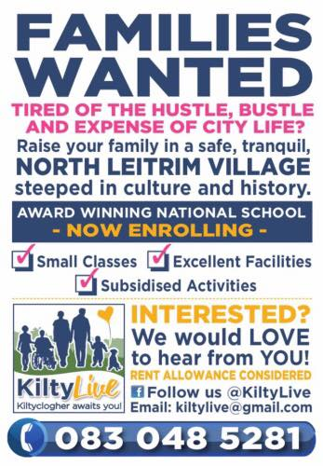
Watch our in-depth video case study with Kiltyclogher Community Council

Slide 37
8 years of strategic and sustainable planning –Coolaney National Mountain Bike Park, Ireland
In June 2012 Coillte supported by Failte Ireland launched their Off Road Cycling Strategy. In this document, Coolaney, Co Sligo was identified as a potential National Mountain Biking Center.
As a result a Steering Group was established in Sligo to develop Coolaney National Mountain Bike Park. In 2020, phase one of five of the world-class 80km National Mountain Bike Trail Centre consisting of 76km of single track cycling trails and related facilities was opened to the public.
FIND OUT MORE: Coolaney Mountain Bike Park on Facebook
Coillte Maps and Information on Coolaney Mountain Bike Trails
CASE STUDY

Slide 38
In this Restart+ video case study, Damien McGuinn chairperson of Coolaney Development Company tells us about the process of developing the Coolaney National Mountain Bike Park

Slide 39
SECTION THREE: Creative Placemaking
Creative placemaking shapes the physical and social character of a neighbourhood, town, city, or region around arts and cultural activities.

Slide 40
Creative Placemaking
Creative placemaking animates public and private spaces, rejuvenates structures and streetscapes, improves local business viability and public safety, and brings diverse people together to celebrate, inspire, and be inspired
Projects: Development that is built around and inclusive of the arts, such as museums, performance halls, public art displays or structures for local artists.
Activities: Outdoor town square concerts, sculpture loan programs, public art contests or movies and plays in the park.
Source

Slide 41
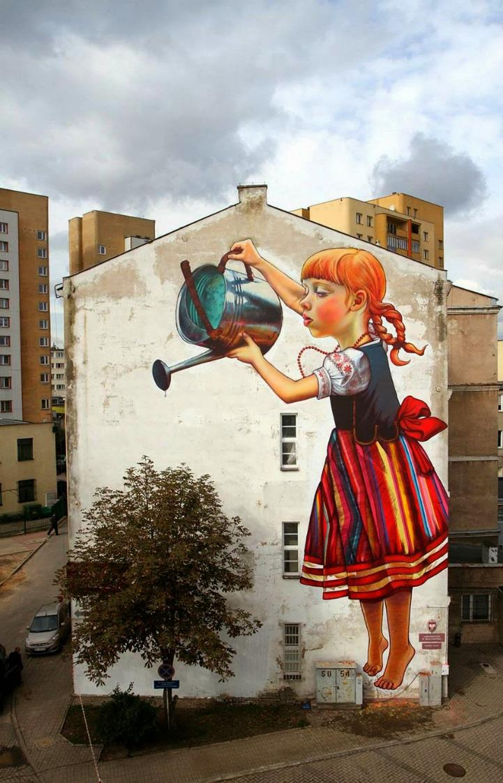
CREATIVE PLACEMAKING IDEA
Street Art – plays a striking role in encouraging urban regeneration and creating a sense of place
Street art promotes place-making through the creation of meaningful spaces and can assist the urban regeneration process by reinventing, rejuvenating, and occupying a city, building or urban space.
Successful street art creates real, tangible benefits, often becoming an integral or even beloved part of a community. It enriches people’s lives by enhancing their environment, it connects communities, prompts engagement, discussions, and learning.
It fosters civic pride, and promotes cultural participation.
Source

Slide 42
Draw Out - an urban regeneration initiative bringing Streets to Life in Limerick, Ireland
Draw Out is an urban regeneration initiative that uses street art to reinvent urban spaces in Limerick. With many derelict and vacant sites in Limerick’s urban centre, it is easy to become desensitised to our surroundings. Draw Out aims to visually reinvigorate these sites. We want to get to a point where urban art speaks and appeals to everyone and impacts on our urban landscape.
Draw Out work in partnership with Limerick City Council to select derelict sites within prime locations across the city. The initiative aims to build on the naturally innovative spirit of the artist by reimagining the urban environment, and creating pathways for art, artist and audience to fully actualize their potential within the urban landscape, creating a synergy between community, artist and environment.
FIND OUT MORE: https://drawout.ie/
CASE STUDY

Slide 43
Watch this Time Lapse Video and see how a Mural being painted over 3 Days on Thomas Street in Limerick comes to life…

Slide 44
Contemporary Urban Arts Festival Brings Annual Art Installations And Visitors To Dundalk Ireland
SEEK highlights the important influence art can have in the public domain, its role as a catalyst for change, helping reinvigorate and refresh some of our town centre spaces.
SEEK is an arts and culture festival aimed at attracting some of the worlds best outdoor muralists and urban artists to Dundalk, to help promote the locality culturally and artistically, refocussing the area as a vibrant hub for creativity. From large scale outdoor murals, to artist talks and cultural arts walks, Seek includes a wide ranging and visually engaging series of activities as part of the overall festival.
Culturally Dundalk has been shaped over the ages, with many historical figures and events. With our outdoor art gallery, we hope to generate and inspire local pride and help to forge a new identity based on creativity, while still celebrating our past.
FIND OUT MORE: https://seekdundalk.ie/
CASE STUDY

Slide 45
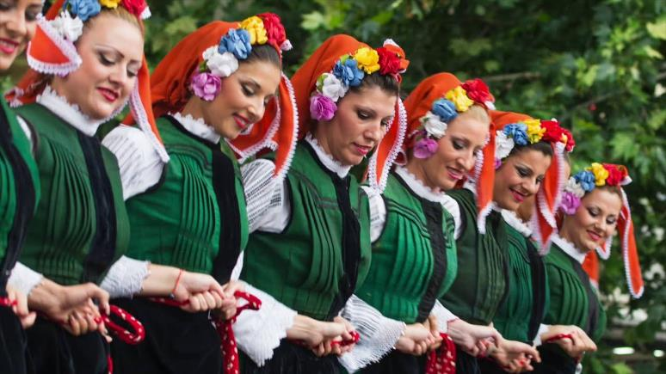
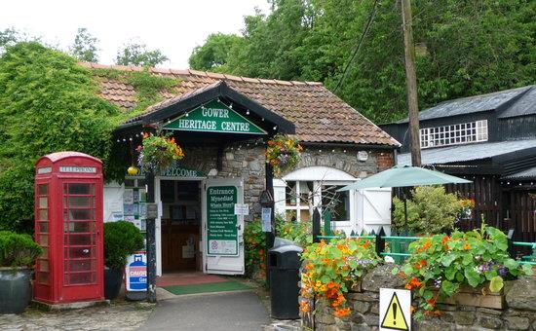
CREATIVE PLACEMAKING IDEA
Embracing cultural heritage to create a sense of place
Embracing Tradition and Folklore is an important element when trying to create a sense of place. Heritage conservation can enhance people's sense of place because heritage is regarded as the foundation of people's identity and as a representation of the culture of place.
Cultural heritage is found to contribute to sense of place as a source of pride, and by supporting feelings of distinctiveness and senses of continuity across time.
Cultural Heritage describes the range of issues which are of importance to our sense of identity and our knowledge and understanding of our local place.

Slide 46
Dolhesti Folklore Assembly brings traditional Romanian songs and customs to life, Romania
Dolhesti faces depopulation/lack of jobs. A folklore assembly is working to animate and preserve the towns heritage and history.
CASE STUDY
Dressed in traditional attire, Gheorghita Ciocarlan explains some of the challenges

Slide 47
Sligo Folk Park, Riverstown – a community tourism that offers a visit to old village, Ireland
In 1990 a group of Riverstown people came together with the common aim to tackle very prevalent rural decline of the locality. They came from a variety of backgrounds including: agriculture; business; education; professional and community activities. Together they started something that has continued to grow ever since.
Riverstown Enterprise Development (Sligo) Ltd., is a company limited by guarantee. Its first task was to prepare a comprehensive action plan for the locality aimed at making the area one which is both attractive and viable in which to live, work and rear a family. A number of projects were undertaken which contributed to the environmental enhancement of the village and gave employment to the local people. Sligo Folk Park is one such project. The Park is a community based attraction provides a true experience of rural life and Irish heritage at the turn of the late 19th Century.
FIND OUT MORE: https://sligofolkpark.com/
CASE STUDY

Slide 48
SECTION FOUR: Tactical Placemaking
Tactical Placemaking is the process of creating Quality Places that uses a deliberate, often phased approach to change that begins with a short term commitment and realistic expectations that can start quickly (and often at low cost).

Slide 49
Tactical Placemaking
Tactical placemaking is an increasingly popular approach to planning that emphasizes testing projects through a series of phases rather than constructing projects straight from the drawing board. Tactical Placemaking Projects often begin as demonstrations, become pilot projects, and then, if successful, are installed permanently.
Projects: Pop up community shop or temporary conversion of a storage facility into a business space
Activities: parking space conversions, self-guided historic walks
Source

Slide 50
Tactical Urbanism
Tactical Urbanism employs a variety of low-cost, temporary approaches that seek to improve urban services and functions, and inspire possibilities for alternative transportation or other infrastructure options that better activate the public space.
Tactical urbanism can be used to uncover value and demonstrate how an underutilized space could be transformed to contribute to safety, community building, or economic goals.
Tactical urbanism can be used to pilot new approaches which in turn might transform policy or inspire new programs

Slide 51
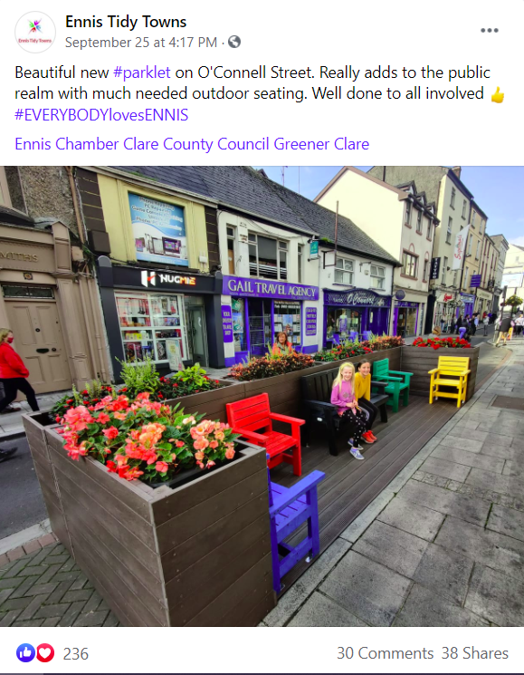
Ennis Town Parklet – a cosy, social stopping space that offer an outdoor seat
A parklet is a sidewalk/street path extension that provides more space and amenities for people using the street. Usually parklets are installed on parking lanes and use several parking spaces. Parklets typically extend out from the sidewalk at the level of the sidewalk to the width of the adjacent parking space.
In Ennis town, a new parklet made with made with 100% recycled plastic has been well received by the community :
“Looks fab great edition to our lovely little town the colour makes things look a bit brighter. They could do with doing this in other areas of the town” “Looks great!” “Great idea!” “Love it, super addition to the town”
FIND OUT MORE: Clare Champion Newspaper
CASE STUDY

Slide 52
Tactical Placemaking and Lighter, Quicker, Cheaper (LQC) activities
Lighter, Quicker, Cheaper Activities involve the introduction of new activities in existing public and community places to infuse them with more life and activity.
LQC activities focuses on activating spaces and encouraging people to engage in various activities whilst there.
Attracting people to sites that offer multiple interesting activities also helps to enhance sense of place within the community and is good for the local economy.

Slide 53
From “pop up” to permanent fixture – Café Fia a standalone community café in Sligo, Ireland
The 'Café Fía' project involves the ongoing development of a community café in Coolaney, County Sligo, a rural village (of 1500 inhabitants) with relatively few facilities and a limited retail offering. To address the need for a café or restaurant as a social meeting place accessible to all, the community established a volunteer-led ‘pop up’ café which was provided on a part time basis in the local community centre.
Operating since 2016 under the name Cafe Fia - named after the deer who roam the nearby mountains - the community initiative has been a major success, leading to plans, and subsequent action, for a permanent facility.
Check out Café Fia on Facebook
CASE STUDY

Slide 54
From “pop up” to permanent fixture – Café Fia a standalone community café in Sligo, Ireland
"There were so many people in Coolaney that didn't have that tie or connection so we wanted to address that, have a place to sit own and have a coffee and knit the community together."
A registered co-operative body, Coolaney Community Café Co-Operative Ltd., was established with the intention of developing and running the cafe. To this end Sligo County Council and the community of Coolaney have together secured funding through a mix of the Town & Village Renewal Scheme and the LEADER Programme to enable the development the cafe as a community asset.
A significant funding allocation of ca. €400,000 was committed to the project with the Café construction complete in 2020.
FIND OUT MORE about the development:
Irish Independent Newspaper
CASE STUDY

Slide 55
Joseph Fogarty gives us a few more insights into how Coolaney Café started as a pop up and developed from there…

Slide 56
Finding the Right Opportunity for Your Community – useful exercises and templates
Key Action Pack 3
The Power of 10 Challenge
5 Step Placemaking Process For Community Regeneration
Parklet Manual
Asphalt Art Guide
These exercises/resources will help you apply what you have learned in Module 2 to your community and help you get ready to start regeneration project planning. Please complete these before moving on to Module 3.

Slide 57
1. The Power of 10 Placemaking Community Challenge
Pick
Pick the area you want to study - it can be a single street, entire community (or even an entire city!). Now take a walk!
Write down
Write down as many places or things to do as you notice (playgrounds, cafes, shops, market, and so on). Be creative! Then, note whether these places are great or have room for improvement.
Print out
Once you return home, print out a Google map of your study area
Grab
Grab three different colors of markers, pens, or sticky dots e.g green or blue for great places, red for unsuccessful ones, and yellow for those that have the opportunity to improve.
Source: PPS.Org

Slide 58
The Power of 10 Placemaking Community Challenge
Review and Rate
Time to rate your places. Based on your notes, mark all of the places you observed with the colored markers or dots.
When you’ve finished, think about the results in the context of the Power of 10 - do you have a network of great places?
Were there more reds than greens or blues?
Where is there room for improvement?
Source: PPS.Org

Slide 59
2. Placemaking Process For Community Regeneration in 5 simple steps
Community Participation
Place Analysis
Experimentation
Animation of Place
Evaluating the process

Slide 60
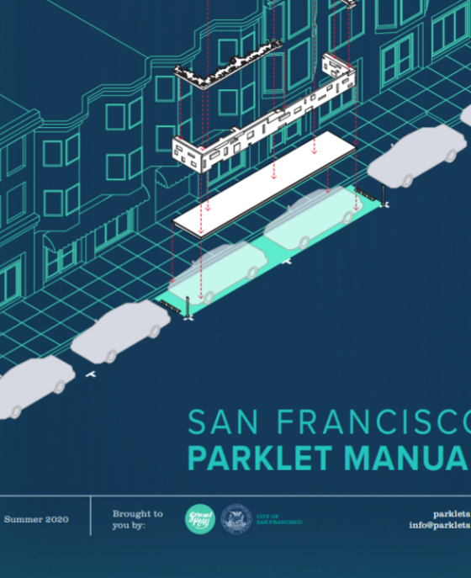
3. Parket Manual
The Parklet Manual is a comprehensive overview of the goals, policies, processes, procedures, and guidelines for creating a parklet in San Francisco (but is tranferable to European Cities, towns and villages).
The manual also serves as a resource for those working to establish parklet programs in their own cities. The manual guides you through the entire process from submitting a proposal to implementation and maintenance.
Access and download the manual HERE

Slide 61
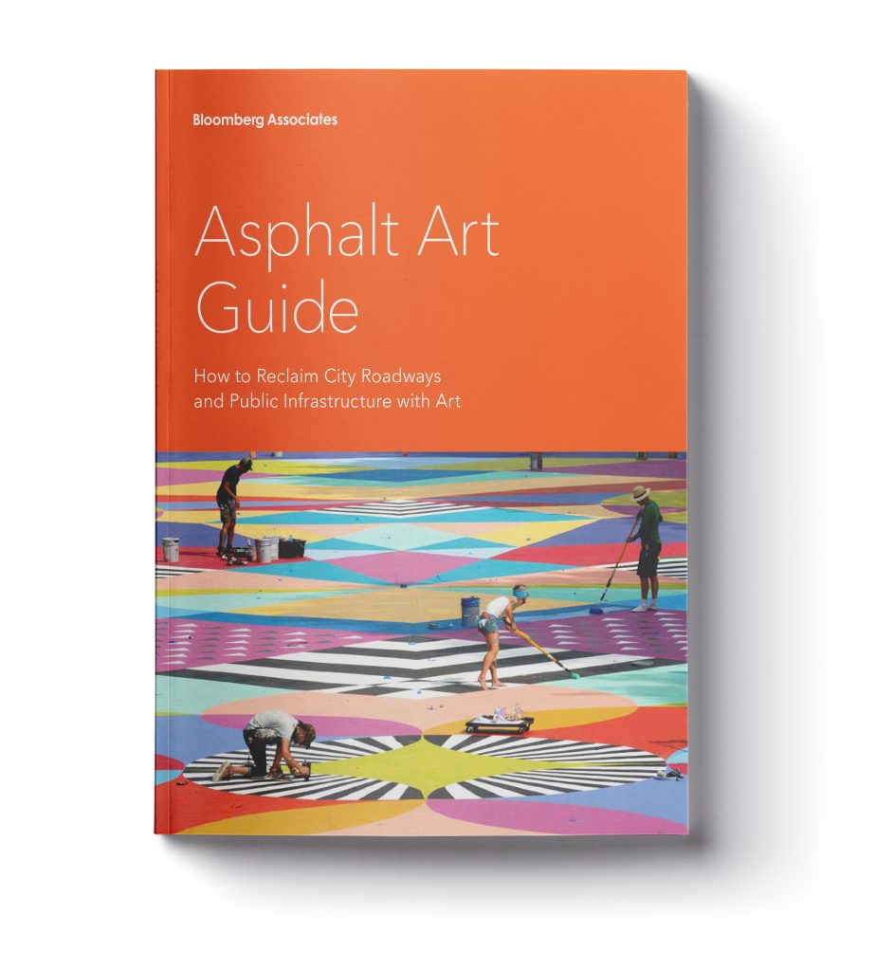
4. Asphalt Art Guide
The Bloomberg Associates Asphalt Art Guide features successful plaza and roadway art activations around the world, as well as key steps and tips for developing such projects.
Access and download the guide HERE

Slide 62
MODULE 3: KEY TAKEAWAYS - PLACEMAKING – A POWERFUL TOOL FOR COMMUNITY REGENERATION
In Module 3 we found out about placemaking and it can be used to further your community regeneration goals. So what did we learn?
Placemaking is a community development/regeneration approach that put the people from the place at the heart of the process. It is fundamentally about inclusion and shared community ownership.
There are four different types of placemaking but there is no one size fits all approach – each community needs to find and apply the approach that best suits their needs or project
Tactical placemaking can be an especially powerful approach for communities as it test/trials a project idea and provides proof of concept as in the case of the Coolaney Community Cafe

Slide 63
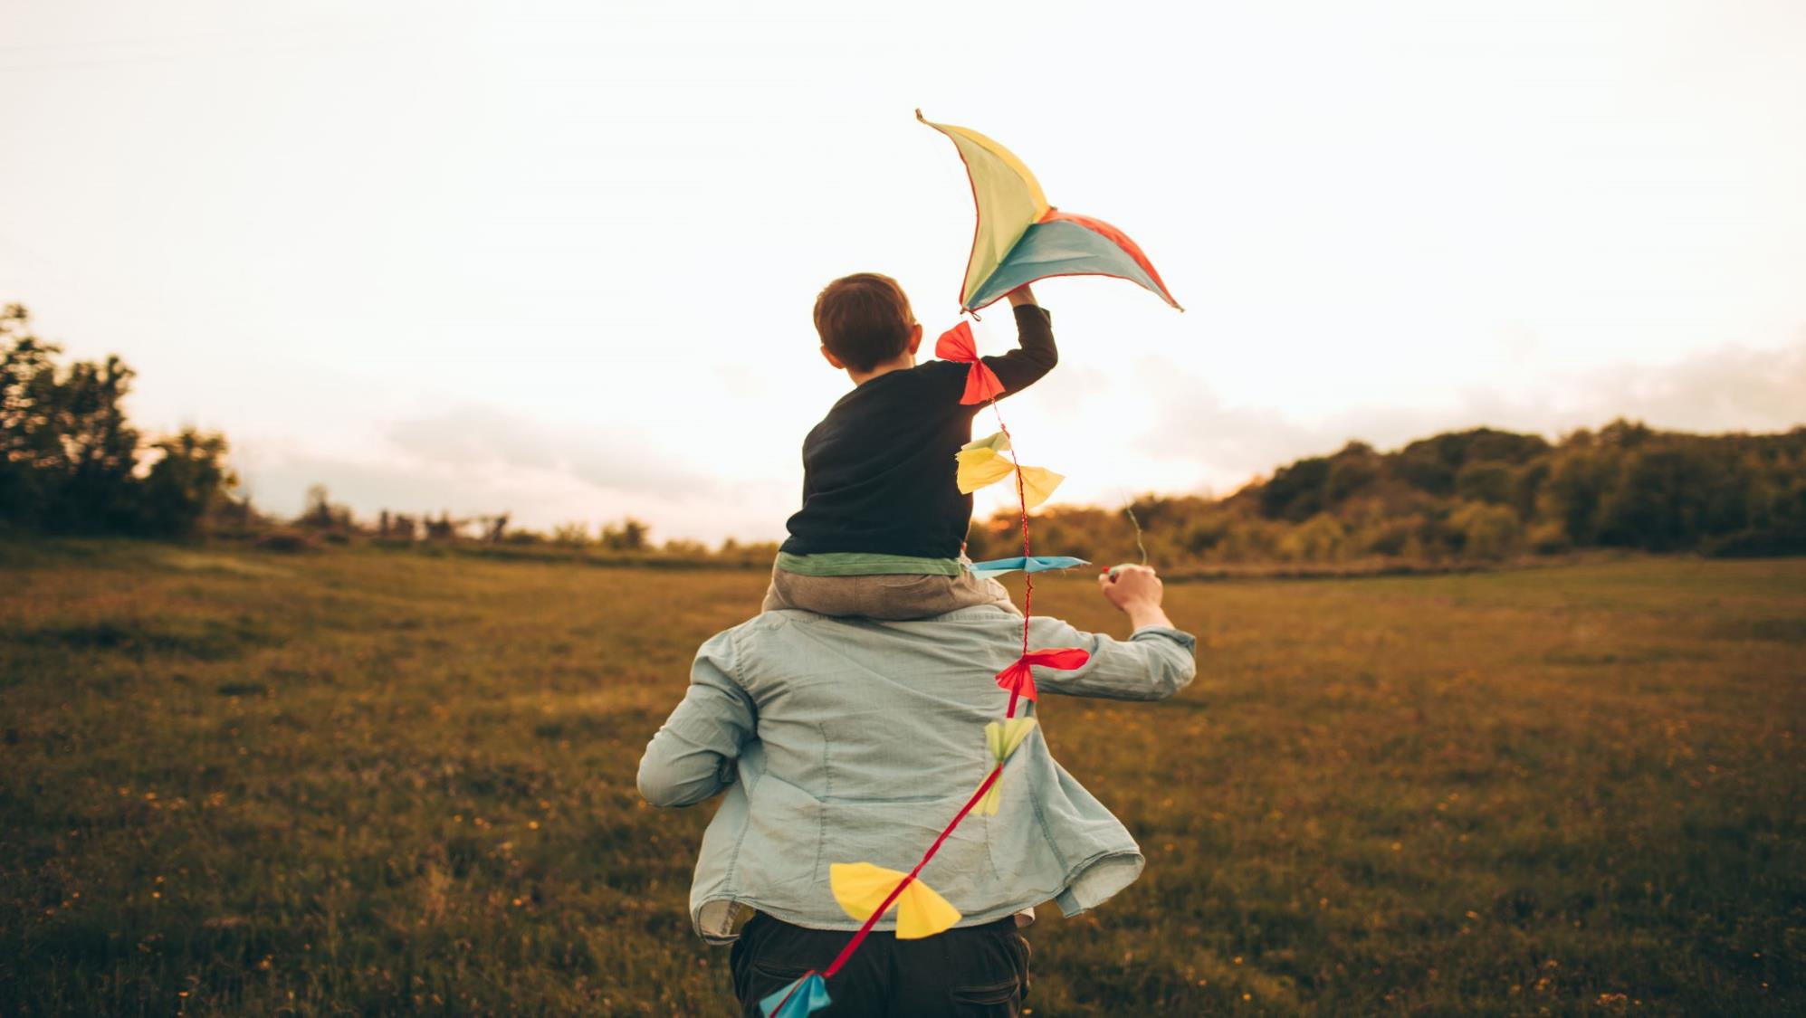
NEXT UP: Module 4
Collaborating and Partnering for Community Regeneration Success
In Module 4, we will look at some key connections your community could benefit from and the role of external stakeholders in your community regeneration projects.

Slide 64
Key references for Module 3
Designing and planning for play

